Slide 1
Introduction to ios development
Mile Praštalo, Dejan Dragić
Novi Sad, 13-5-2023

Slide 2

What is IOS Development
01

Slide 3
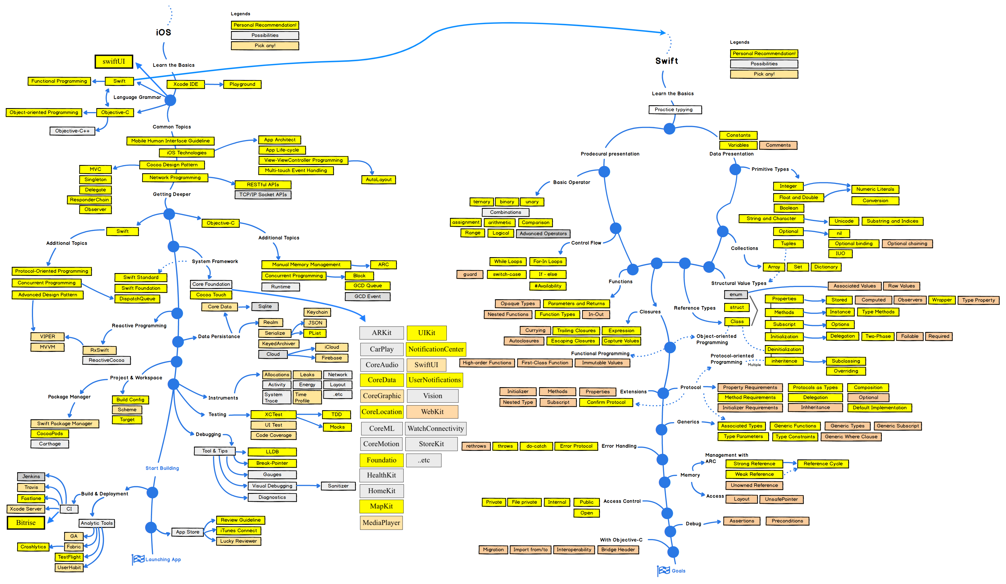
What is IOS Development

Slide 4
iOS development basics
Be aware of user behavior, needs, context, and focus time.
Users do not tolerate apps slow to open or operate.
Too much buttons, dropdowns, editable fields can demotivate the user and led to abandoning the app
Do not translate the desktop app into the mobile one
Stick with platform best practices to accomplish all of this.

Slide 5
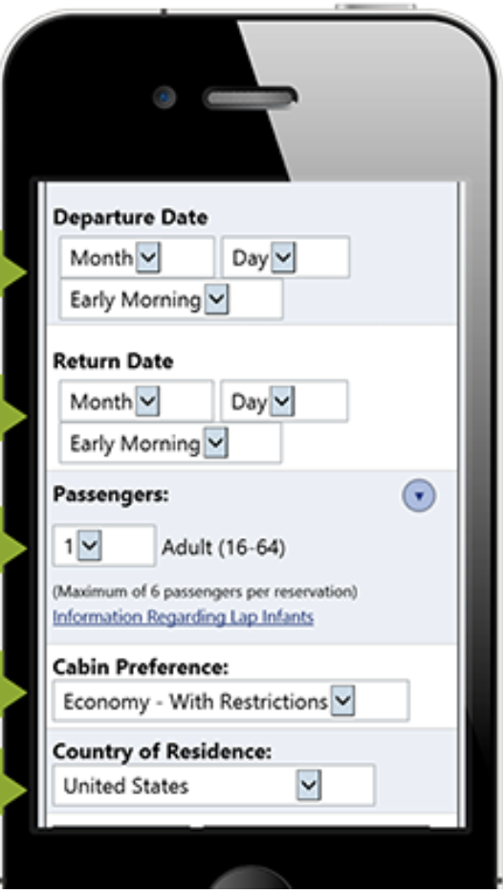
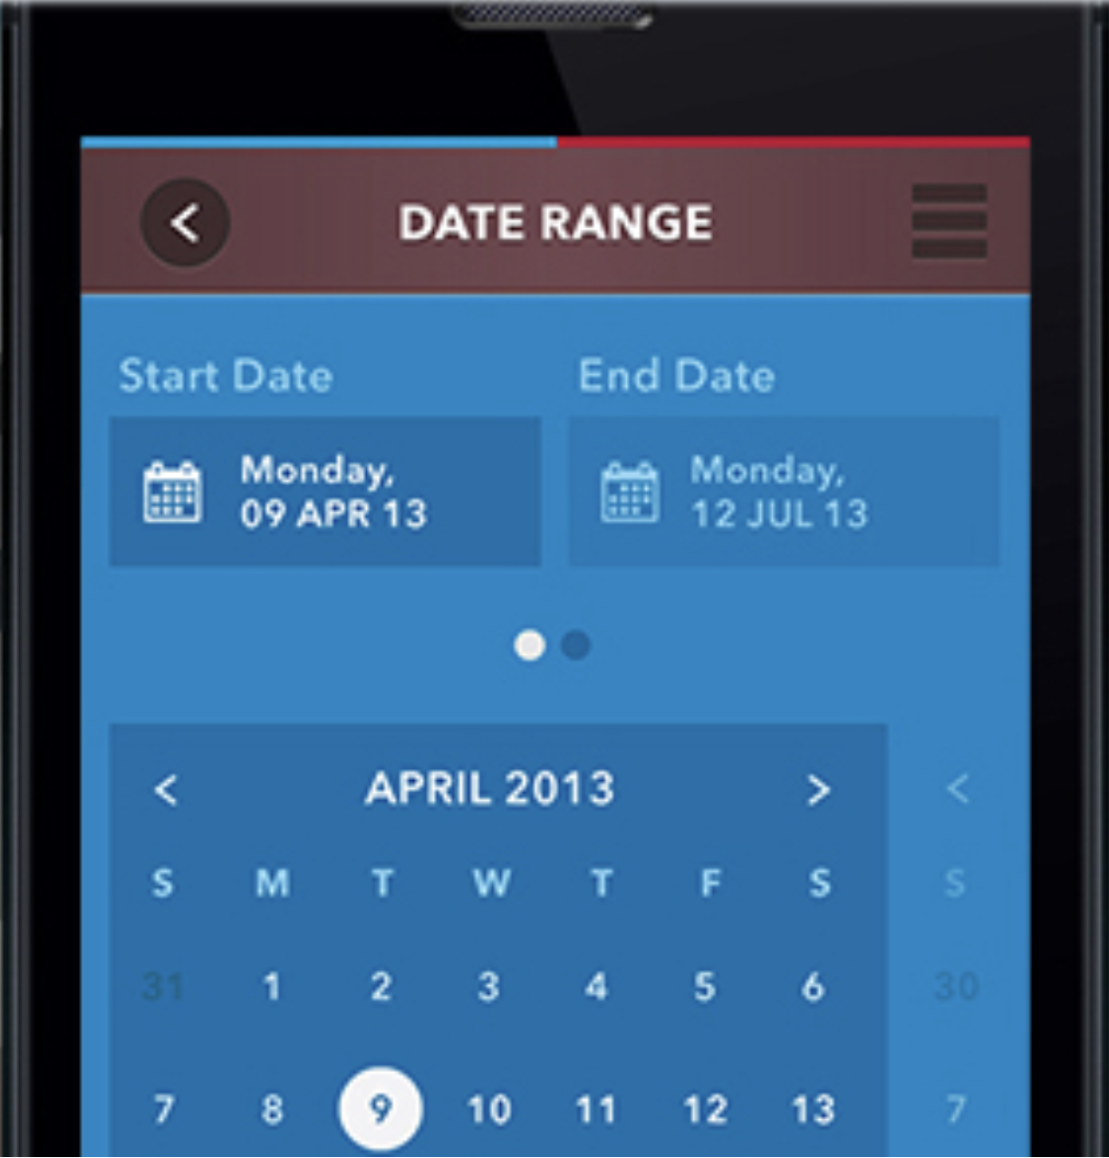
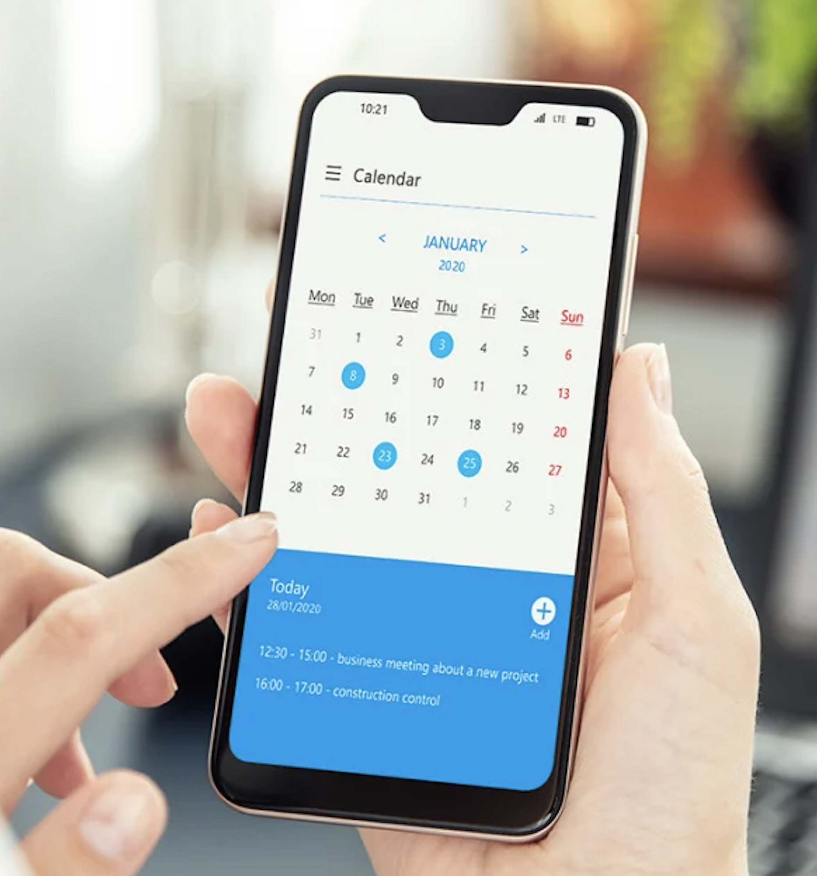
iOS development basics

Slide 6
iOS development basics
From technical point of view, small differences from desktop development:
Rely on core services instead of long background processes
Every process, or routine that impacts UI and its transitions, has to be finished in a reasonable short time. How short? It is defined by iOS standards, user habits, and best practices.

Slide 7
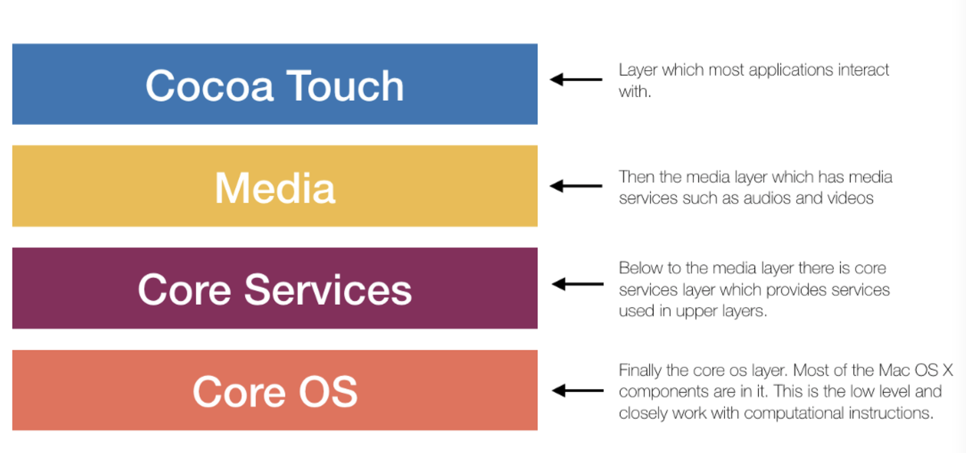
iOS architecture

Slide 8
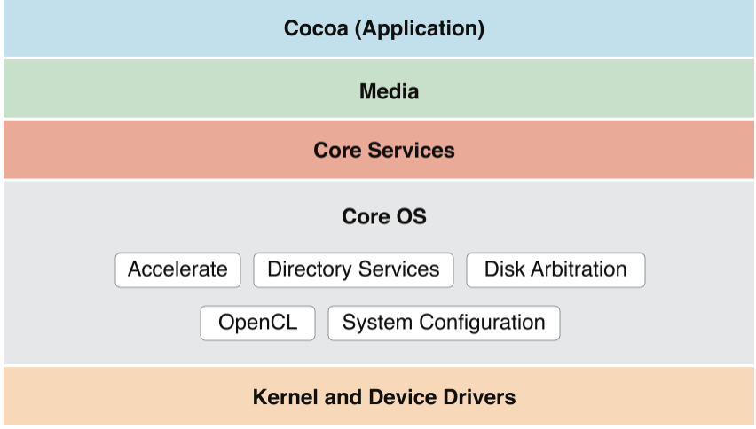
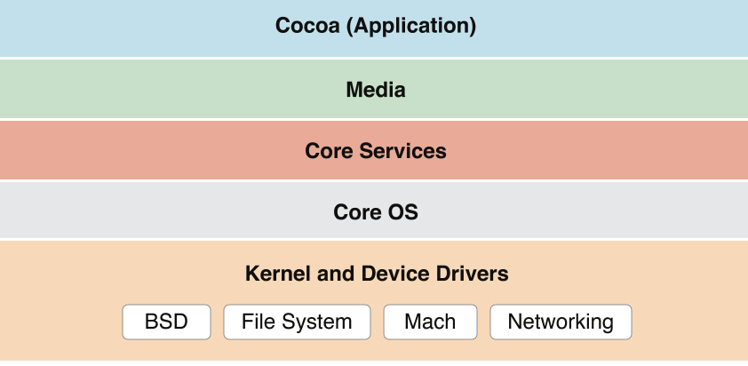
iOS Architecture – core os
OS kernel, power management, file system, certificate controls
Implemented in low level - C, Unix.
It has limited access, communication with external hardware, OS method calls…

Slide 9
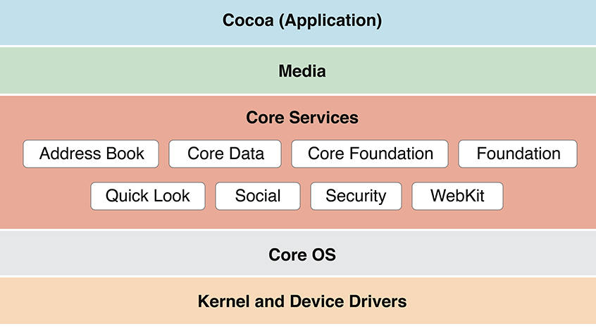
iOS Architecture - Core Services
Object Oriented layer, on top of CoreOS
Access to different services opened for app development in upper layers
location, data models, orientation, screen size…

Slide 10
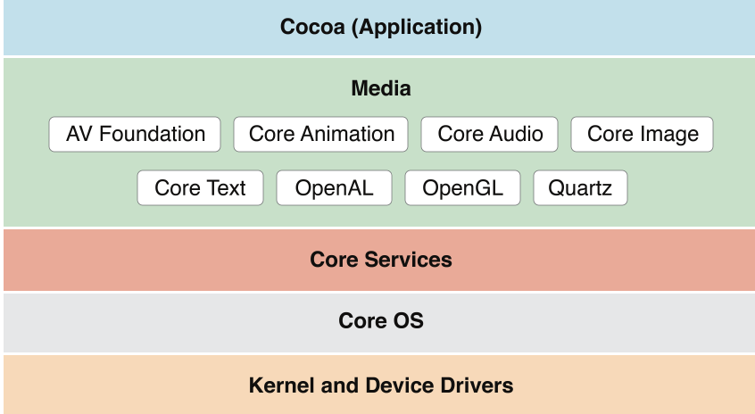
iOS Architecture - MEDIA
Audio functionality
Video functionality (animations, video effects)

Slide 11
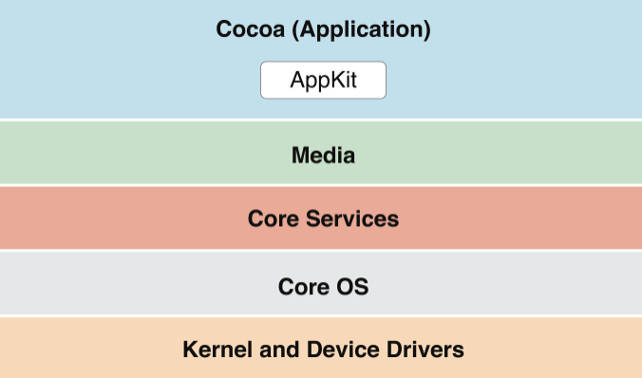
iOS Architecture - Cocoa Touch
View Hierarchy - Buttons, Labels, Images
Alerts, Controls, Tap events app responds to
UIKit like Map, Message or Web (can be imported as a View and give its features)

Slide 12
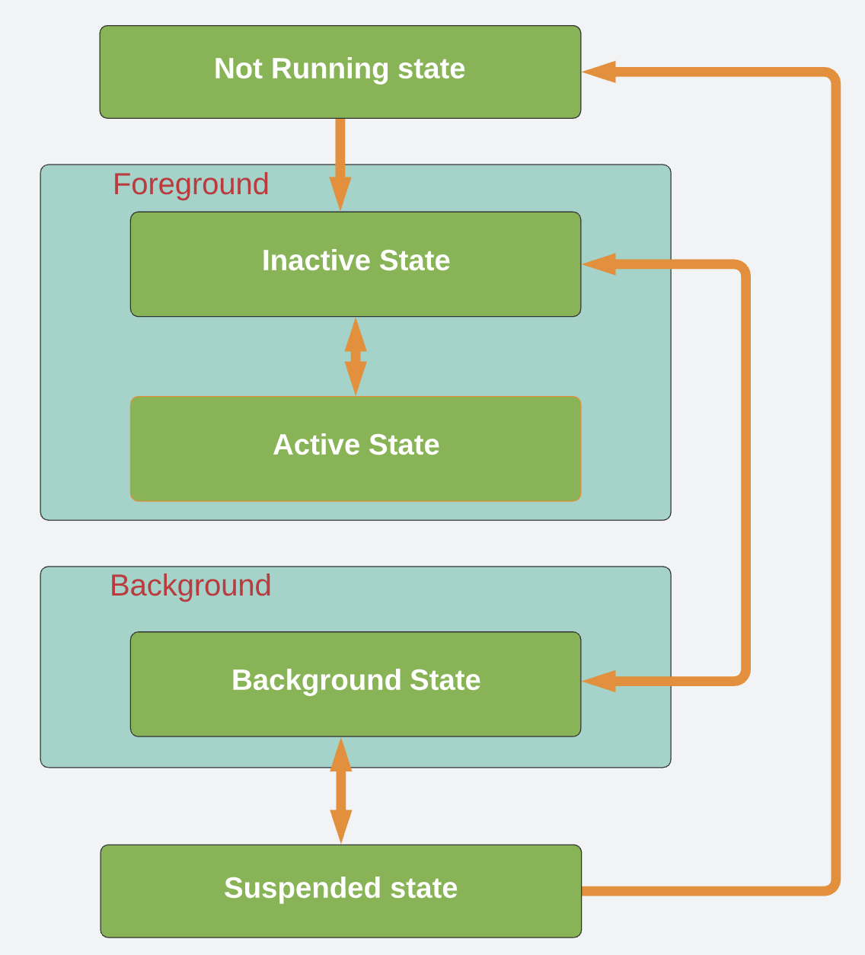
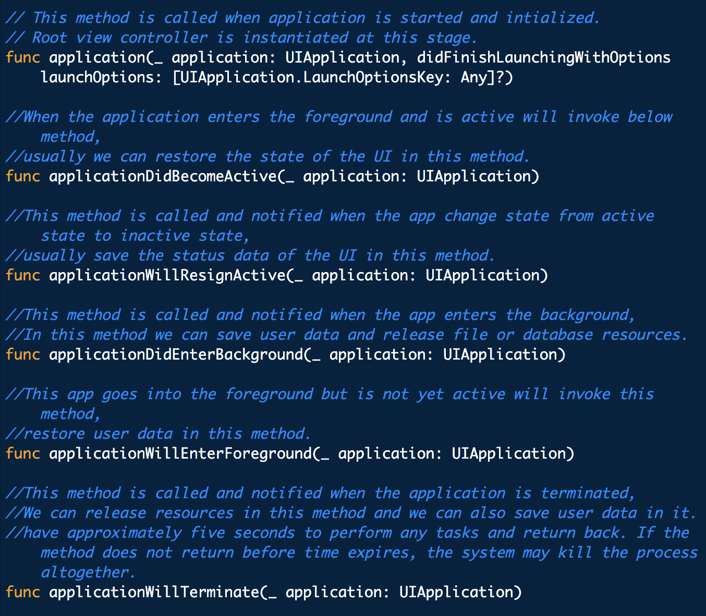
App lifecycle

Slide 13
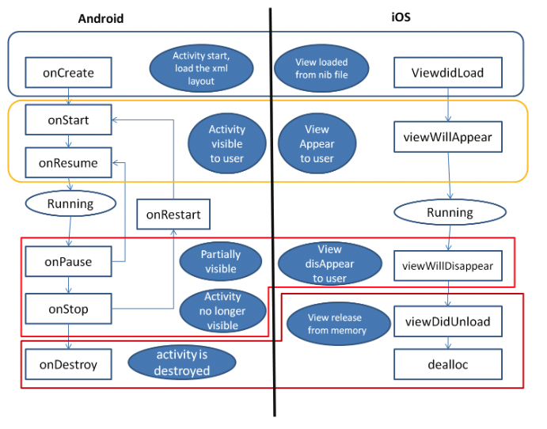
View controller lifecycle
ViewDidLoad - Called when you create the class and load from xib. Great for initial setup and one-time-only work.
ViewWillAppear - Called right before your view appears, good for hiding/showing fields or any operations that you want to happen every time before the view is visible. Because you might be going back and forth between views, this will be called every time your view is about to appear on the screen.
ViewDidAppear - Called after the view appears - great place to start an animations or the loading of external data from an API.
ViewWillDisappear/DidDisappear - Same idea as ViewWillAppear/ViewDidAppear.
ViewDidUnload/ViewDidDispose - In Objective-C, this is where you do your clean-up and release of stuff, but this is handled automatically so not much you really need to do here

Slide 14
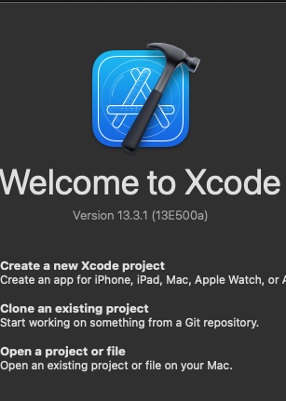
Xcode Overview
02

Slide 15
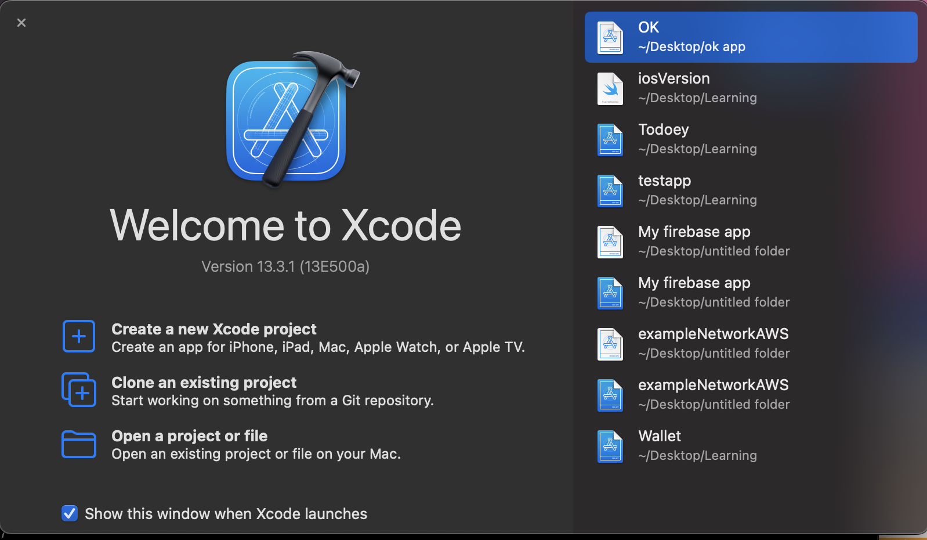
Opening Xcode
Introduction to ios development

Slide 16
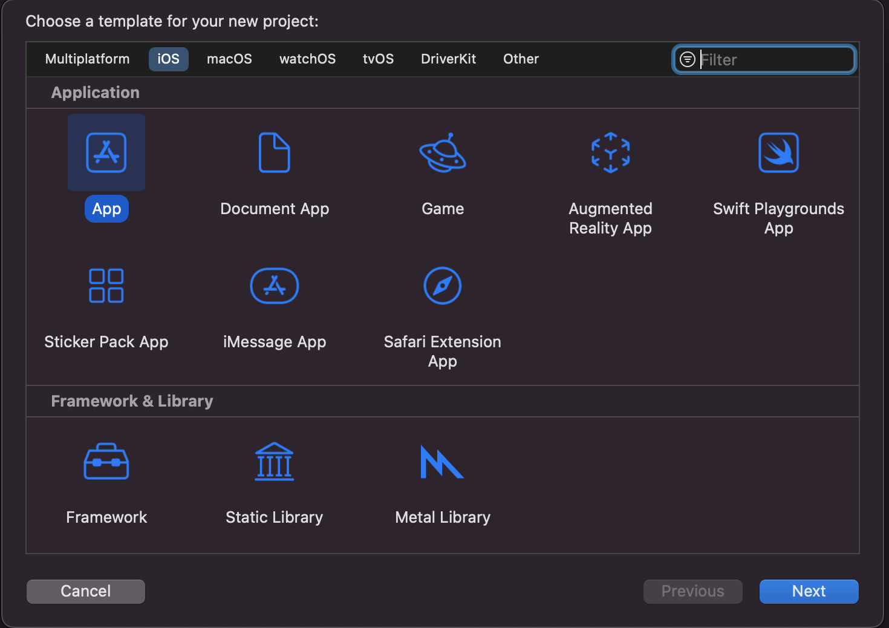
Create new xcode project
Introduction to ios development

Slide 17
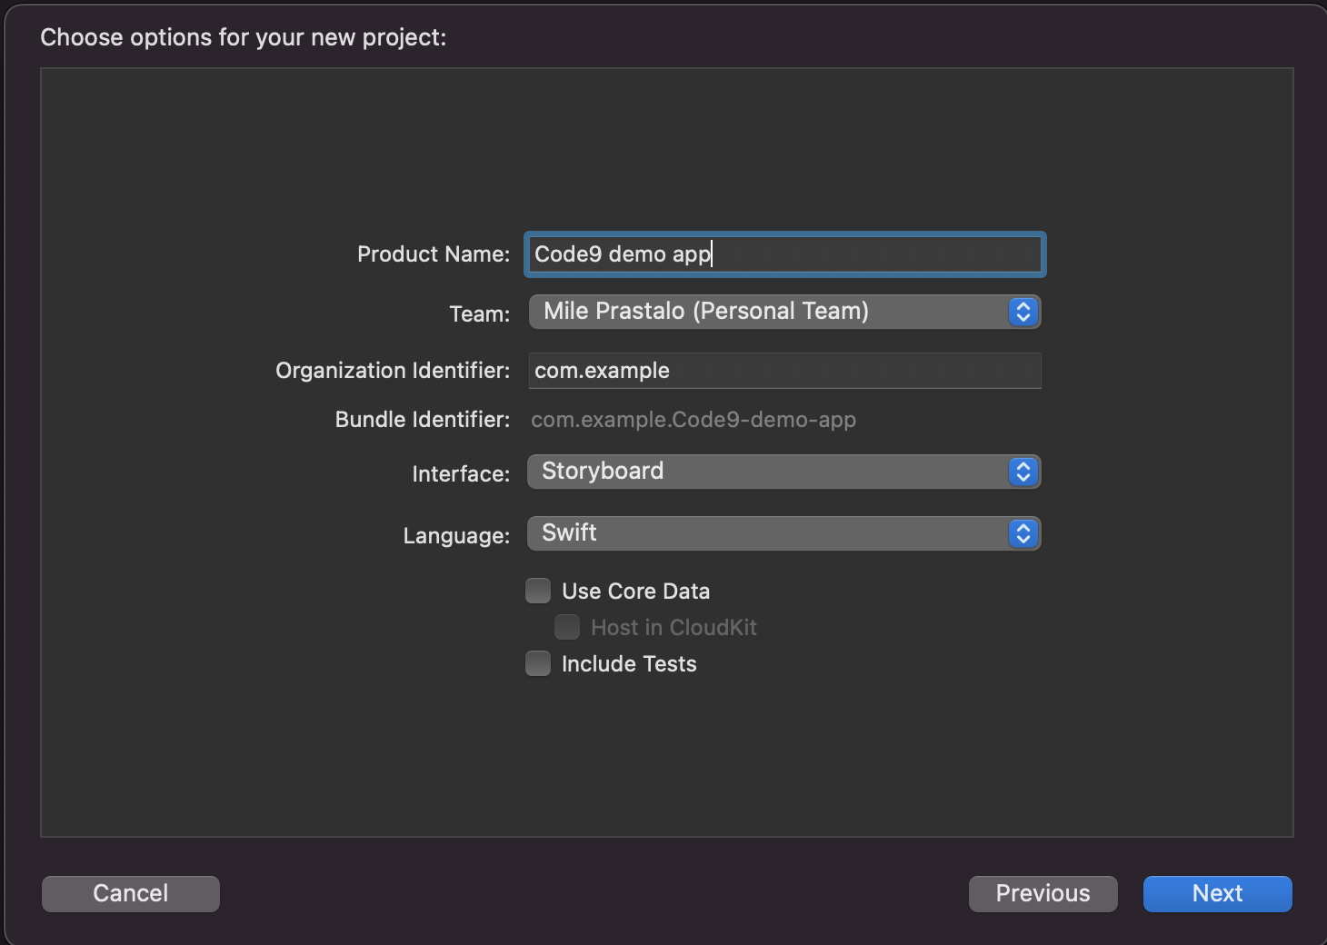
New project options
Introduction to ios development

Slide 18
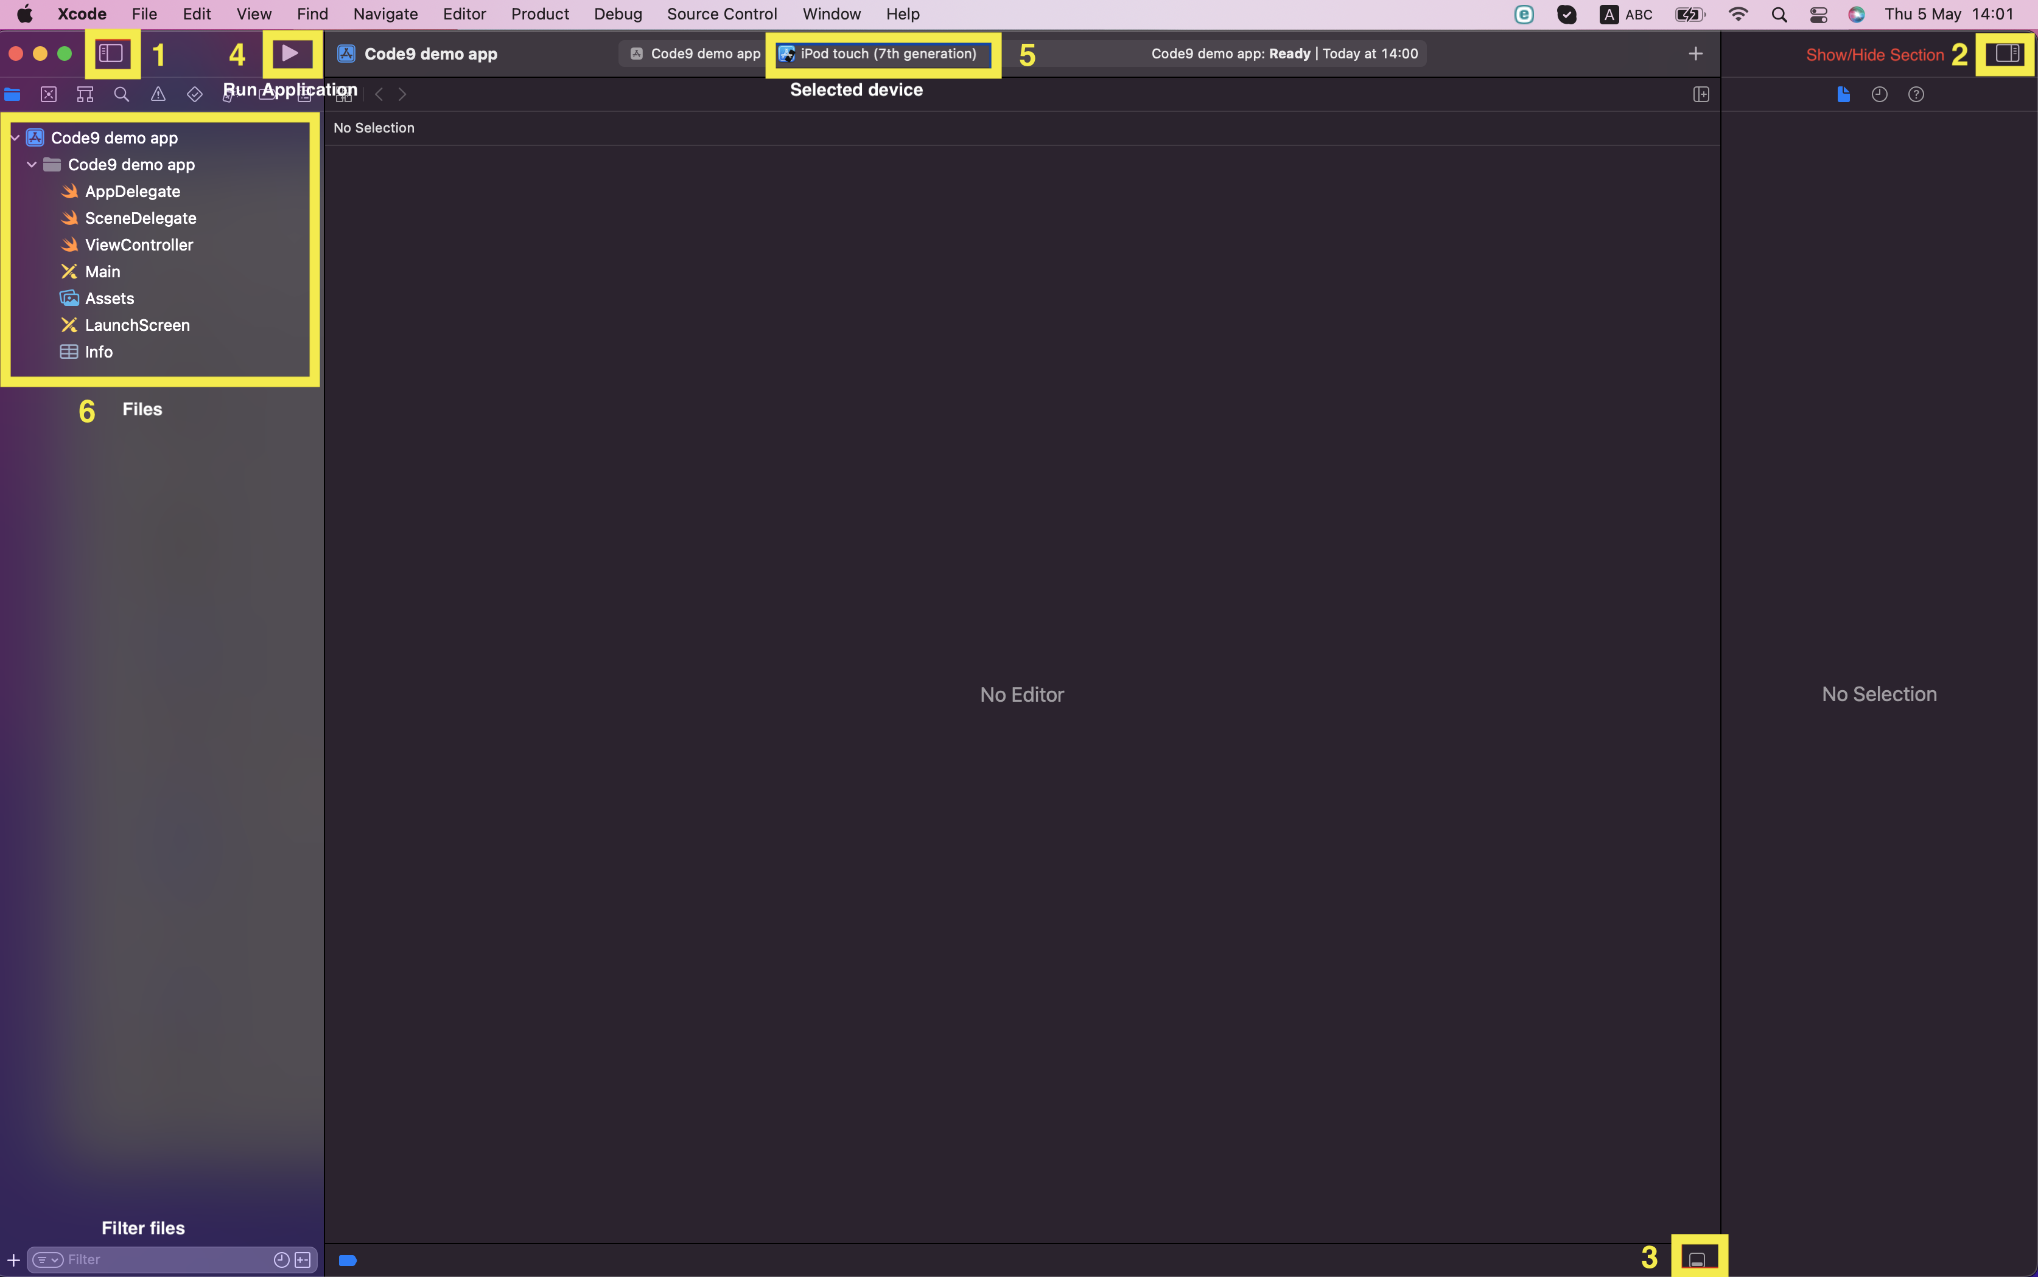
Title of this presentation (Footer Text)

Slide 19
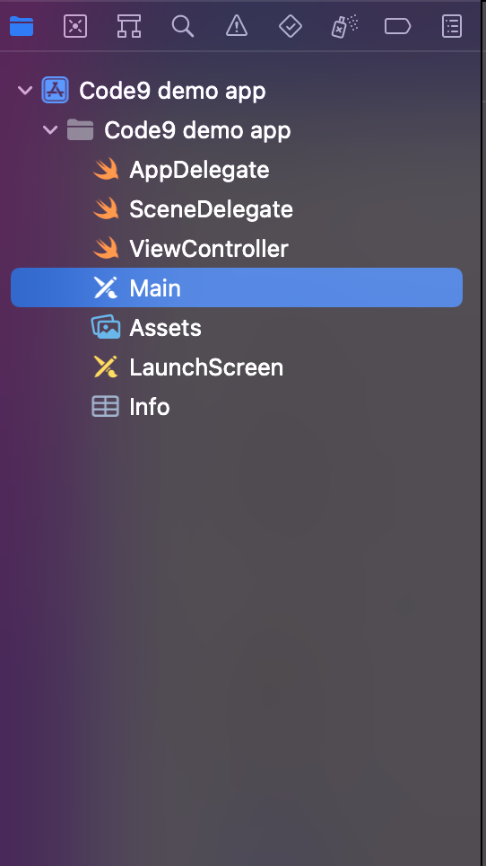
Xcode project generated files
AppDelegate: Responsible for application state. Responds to Application Lifecycle changes.
SceneDelegate: We will skip this for now ☺
ViewController: Contains logic for one screen or part of screen. You will have many ViewControllers in your app.
Main Storyboard: One way of creating UI for your application. You can drag and drop elements to your screens.
Assets: Contains resources for your app like images, icons, theme colors.
Info.plist: Usually contains configuration and info parameters for your application like your app version and permissions that your app requires
Introduction to ios development

Slide 20
Storyboard
One way to create Application UI.
Uses drag and drop of UI elements on canvas
You can have more storyboards. By default there is Main storyboard.
Alternatives:
Creating UI using code
SwiftUI
Introduction to ios development

Slide 21
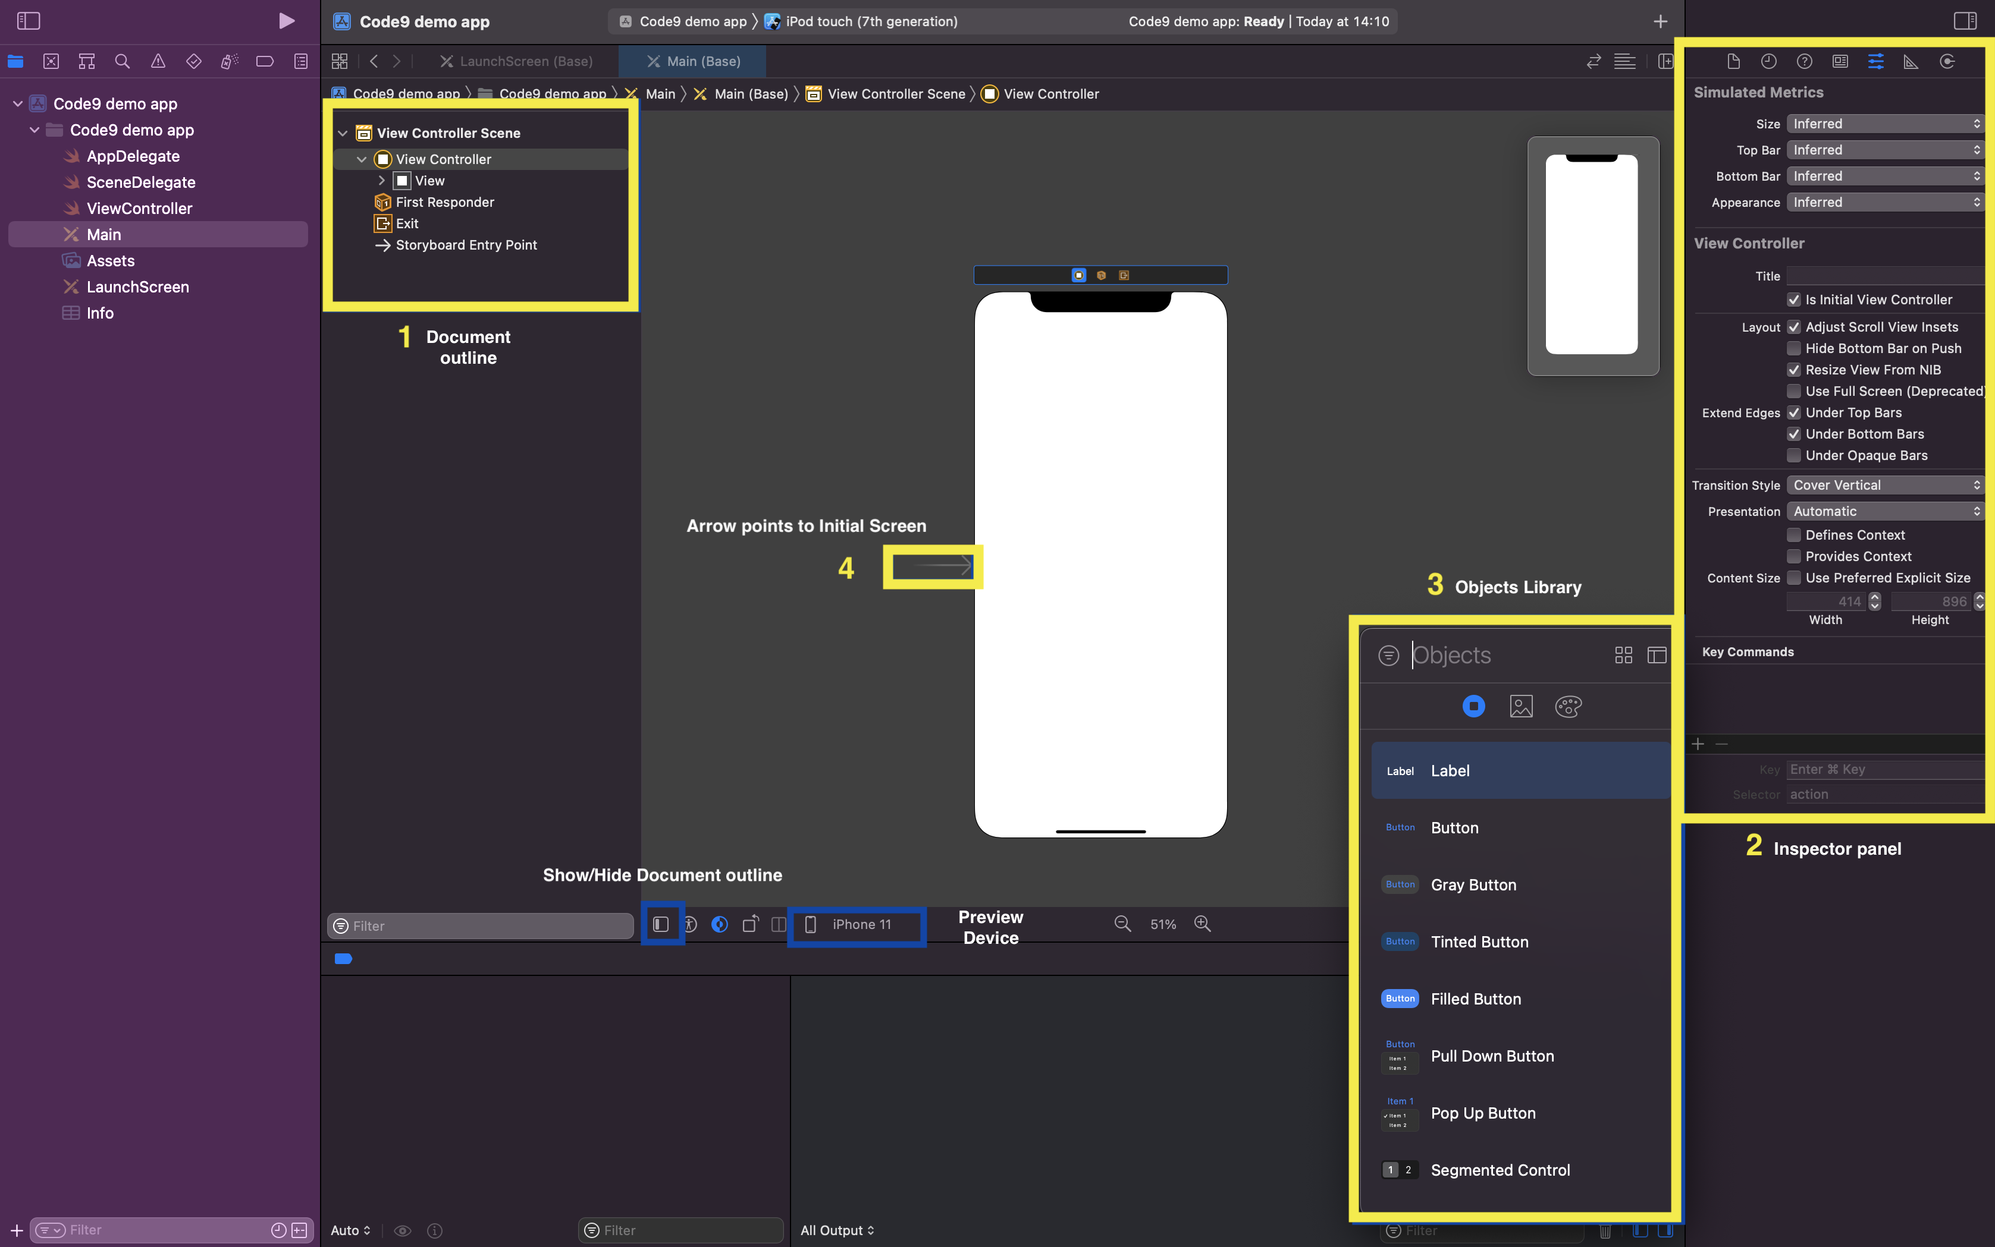
Title of this presentation (Footer Text)

Slide 22
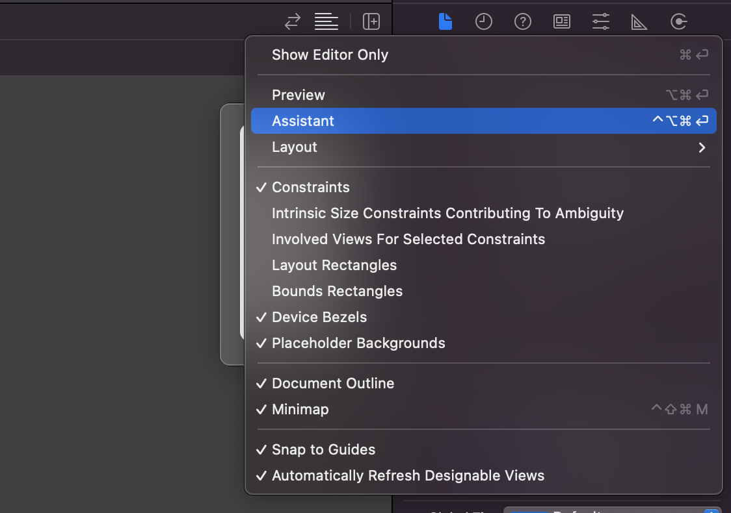
Opening Assistant panel
Often you will need to connect your UI elements to your code.
You can use Assistant panel to do it.
Introduction to ios development

Slide 23
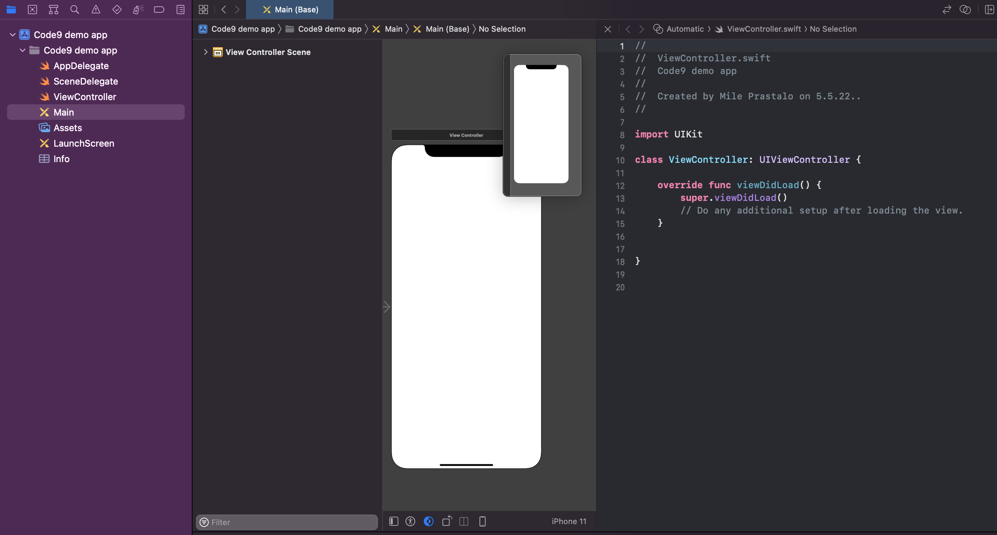
Assistant panel
Introduction to ios development

Slide 24

Quick look into Swift
03

Slide 25
playground
Quick way to try some swift code without creating IOS project.
Playground in Xcode
Online (https://swiftfiddle.com/)
Introduction to ios development

Slide 26
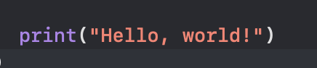
Hello World
Introduction to ios development

Slide 27
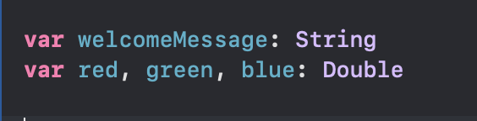
Types
Introduction to ios development

Slide 28
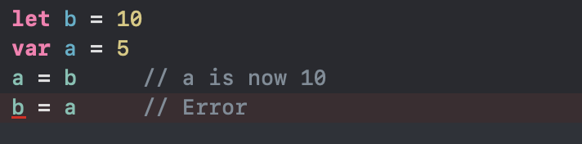
Variables
Introduction to ios development

Slide 29
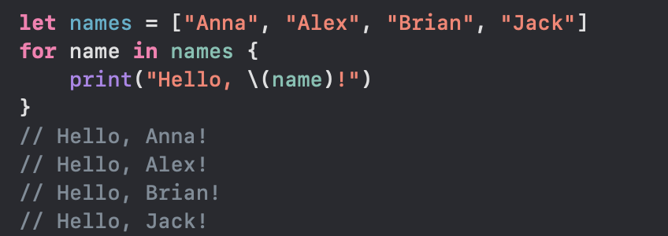
For-In Loops
Introduction to ios development

Slide 30
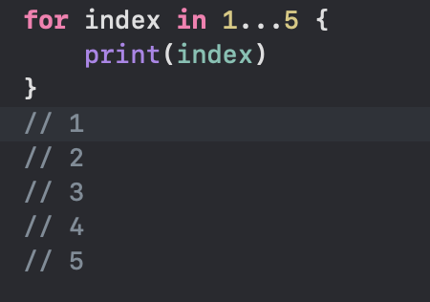
For with range
Use … to include last element
Use ..< to not include last element
Introduction to ios development

Slide 31
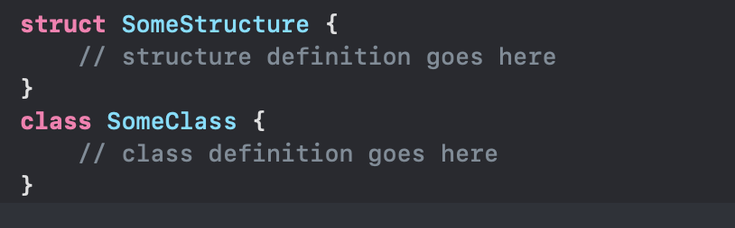
Classes and structs
Class is passed by reference (instances share a single copy of data)
Struct is passed by value (each instance keeps a unique copy of its data)
Introduction to ios development

Slide 32
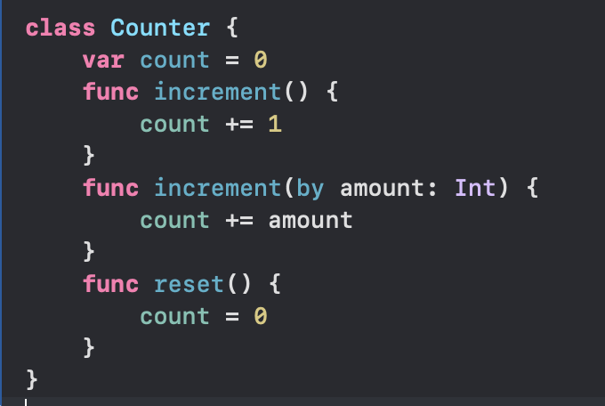
Functions
Introduction to ios development

Slide 33
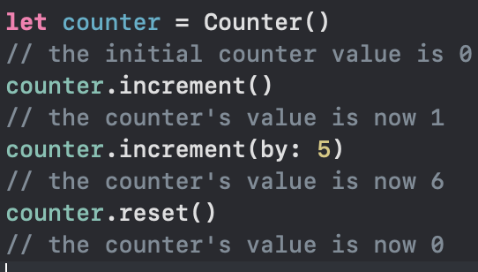
Instance
Introduction to ios development

Slide 34

Mobile / iOS Specifics
04

Slide 35
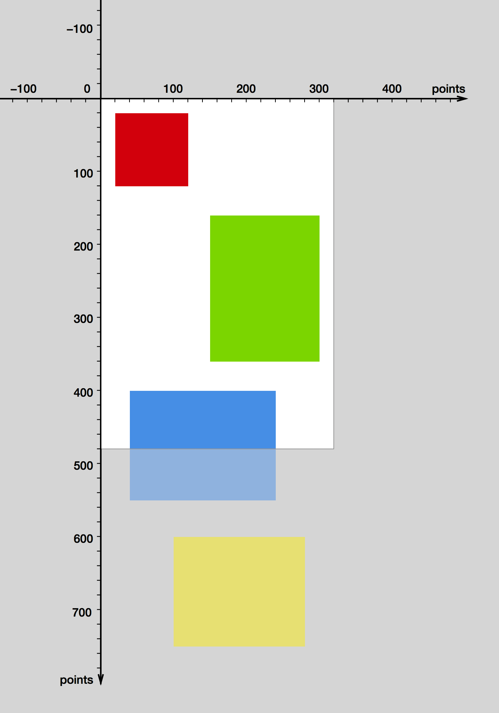
scrollview
Limited content area
Limited memory

Slide 36
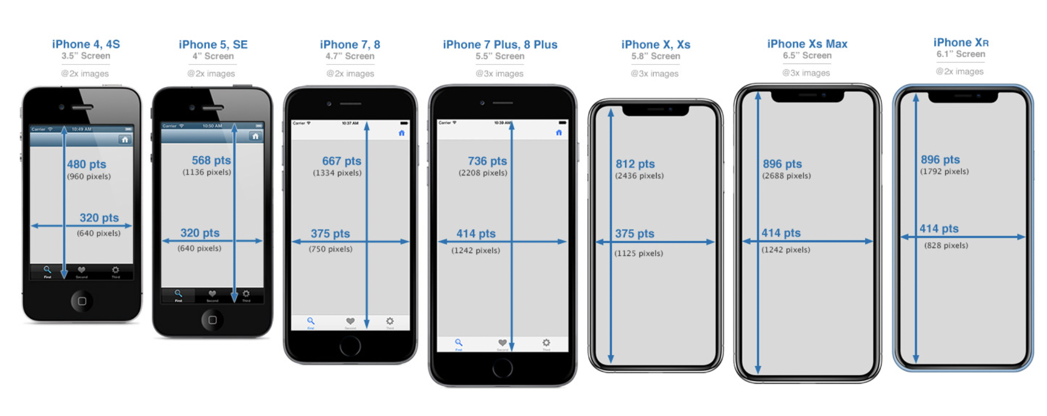
Different Screen size

Slide 37
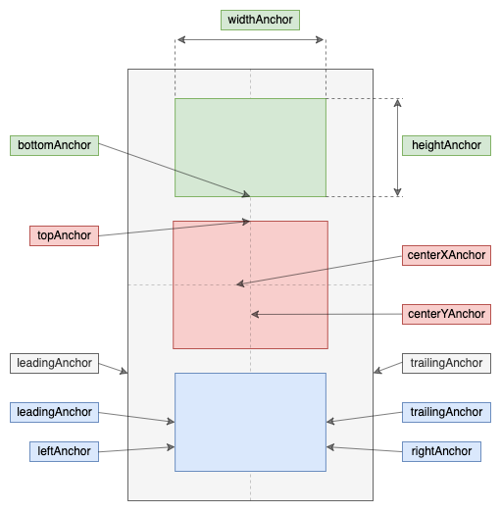
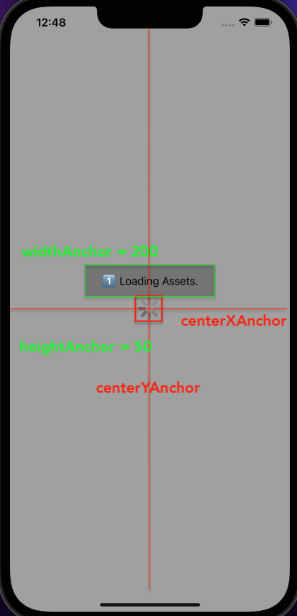
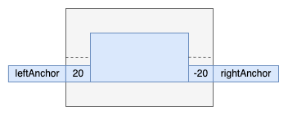
Mobile UI/ux

Slide 38
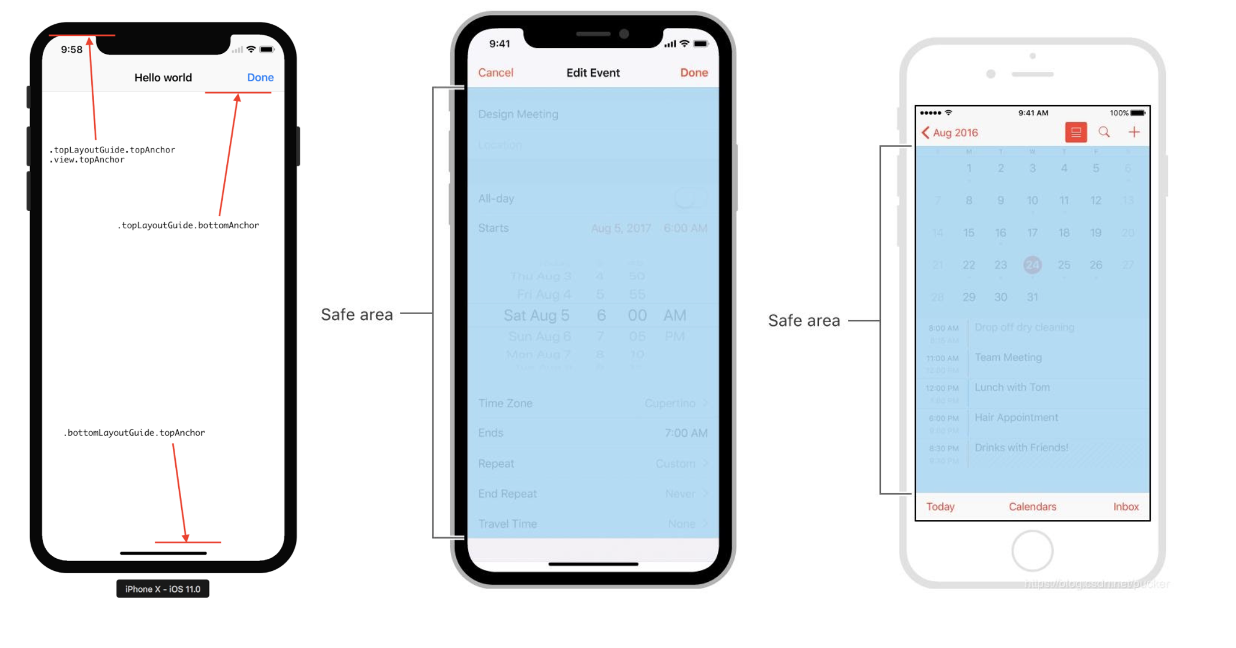
Mobile UI/ux - safe area

Slide 39
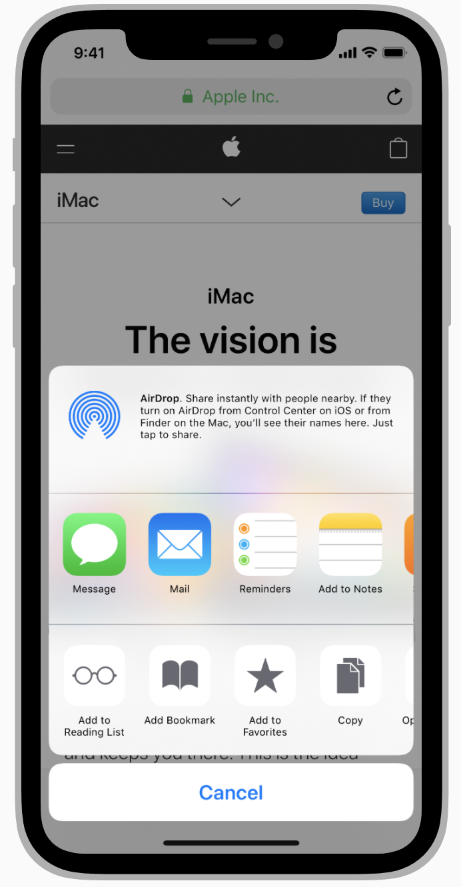
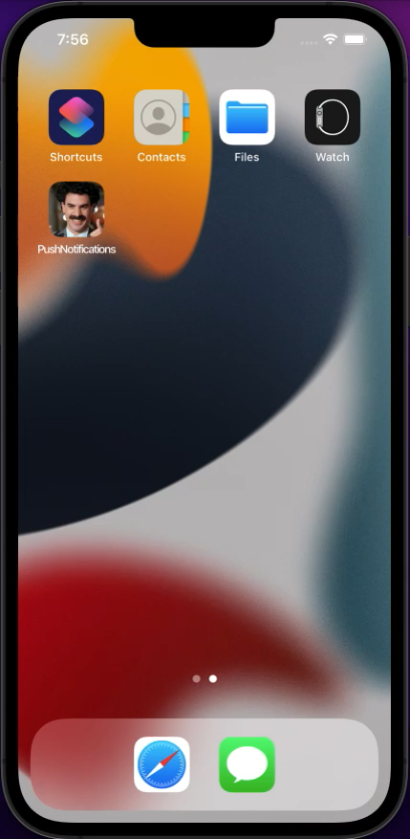
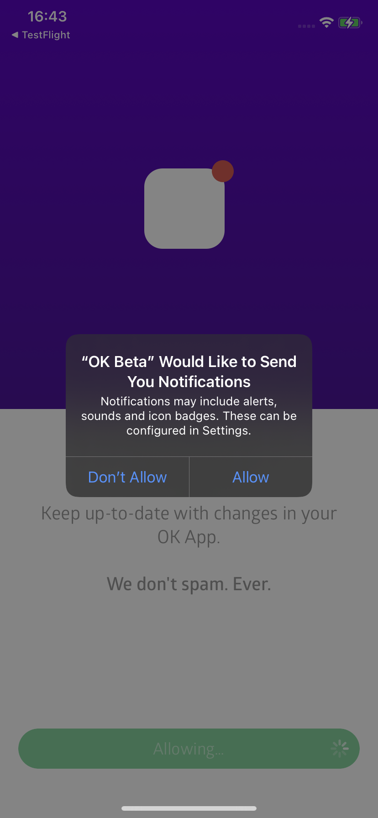
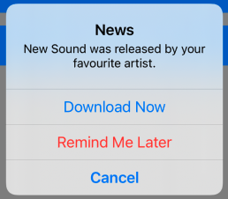
iOS pre defined elements

Slide 40
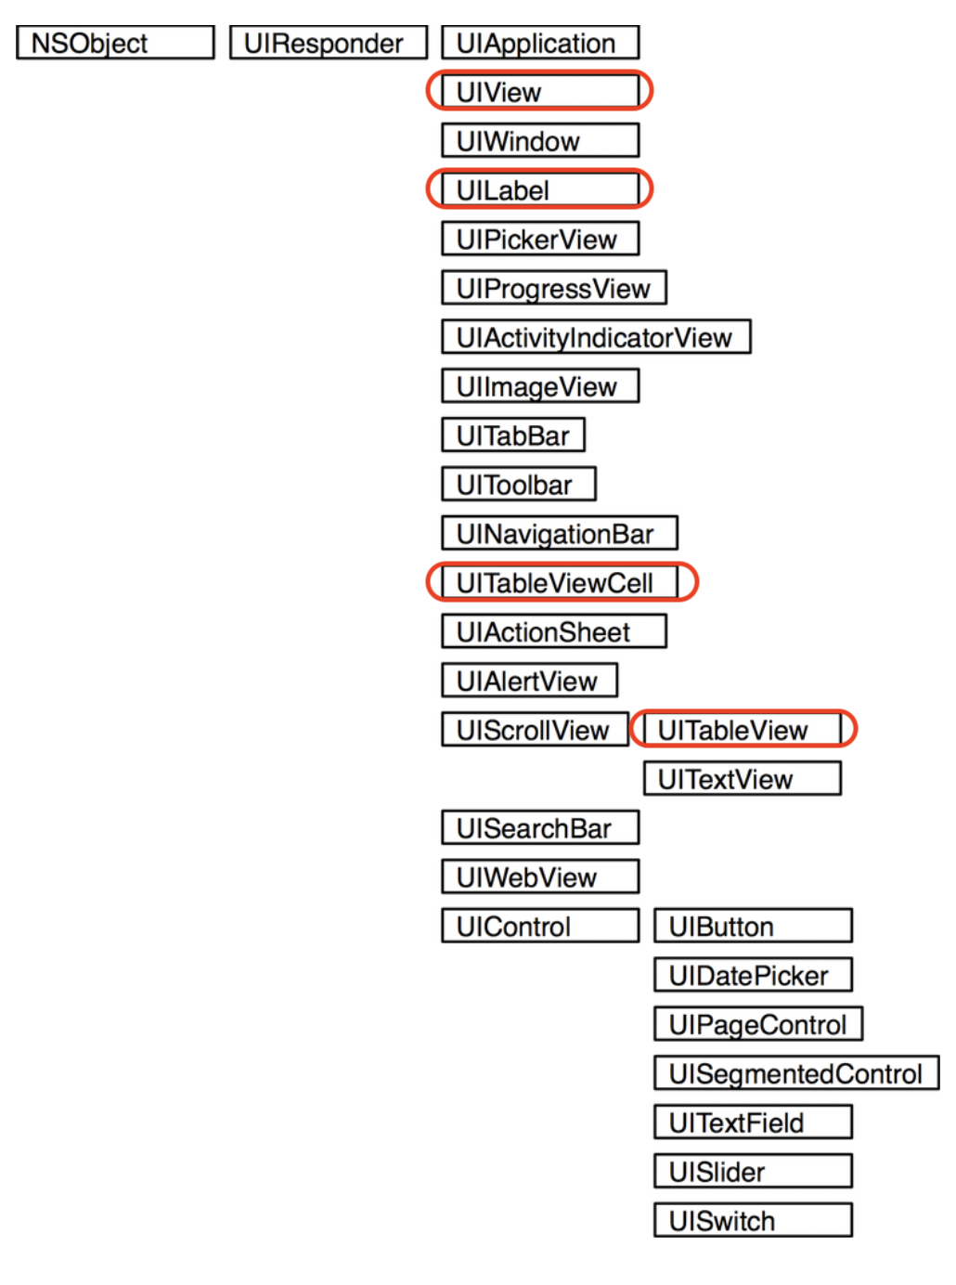
UIKIt Components

Slide 41
Thank you
m.prastalo@levi9.com
d.dragic@levi9.com
SERBIA / NOVI SAD
Levi9 Global Sourcing Balkan d.o.o.
Novi Sad Offices
Trifkovićev Trg 6
21000 Novi Sad, Serbia

